Slide 1
Android Instrumentation
Liu Wei

Slide 2
What is Instrumentation?
Max = 0;
for (p = head; p; p = p->next)
{
if (p->value > max)
{
max = p->value;
}
}
count[0]++;
printf(“In max\n”);
User defined
printf(“In Loop\n”);
count[1]++;

Slide 3
What can instrumentation do
Profiler for compiler optimization:
– Basic-block count
– Value profile
Micro architectural study:
– Instrument branches to simulate branch predictors
– Generate traces
Bug checking
– Find references to uninitialized unallocated data
Fine-grained monitor
Modify environment or change the behavior of applications

Slide 4
Instrumentation
Static Instrumentation
– Source Code Modification
– Compiler Based Instrumentation
– Binary Rewriter
Dynamic Instrumentation
– Direct Memory Modification
– Dynamic Binary Translation
Tools :
– Detours[1] for Windows
– Valgrind[2] for Linux
– Pin[3]
– DynamoRIO[4]

Slide 5
Static Android Instrumentation
Unpack APK
– Convert manifest back to plain text, ...
Disassemble DEX classes
– Get smali code
Instrument smali code
– Modify smali code, add own code
Repackage application
– Compile code, Sign, etc...
Install and run
– Hope it works... (bug in patch, self integrity check, ...)

Slide 6
Dynamic Android Instrumentation
Change/modify application code at runtime
– Allows to add and remove code/hooks on-the-fly
Advantages:
– APK not modified by unpacking, compile, repacking
– Instrumentaion can be turned on/off
– Attach and instrument an already running process
– Instrument library calls
– more fine-grained than existing debug tools

Slide 7
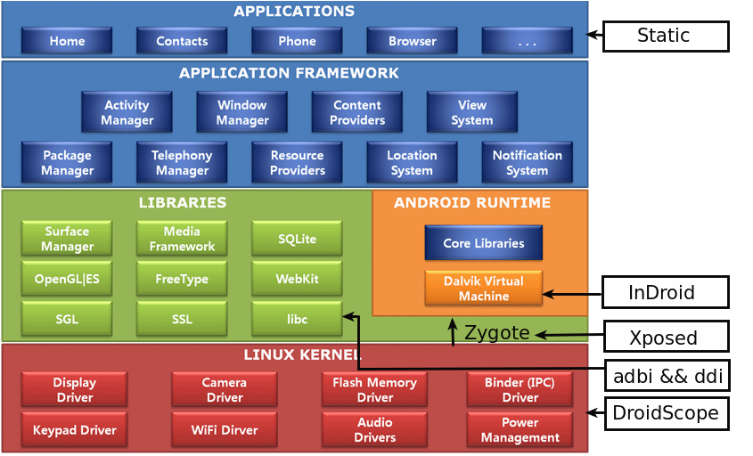
Android Platform

Slide 8
adbi && ddi
adbi[5,6] - Android Dynamic Binary Instrumentation Toolkit
ddi[7,8] - Dynamic Dalvik Instrumentation Toolkit
Developed by Technische Universität Berlin, Germany
Simple but effective tools

Slide 9
adbi
Two Main Steps:
1) Inject Library:
Attach to the process you analyze and insert a dlopen() call to invoke a prepared native share library(.so)
2) Instrument:
The ".so" hook the specific function and instrument whatever you want

Slide 10
adbi – Inject Library
ptrace() process
– Save current state → the registers
Write library loading code to stack; call to dlopen()
– Including saved registers
Call mprotect() to make stack executable
– Write PC via ptrace(), point LR to stack
Execute loading code → call dlopen()
– Repair stack frame (using saved registers)
dlopen() calls library _init() function
– Our code executes inside the target process

Slide 11
adbi – Find dlopen()
Need to put address of dlopen() into loader code on stack
The Android Linker knows
– /system/bin/linker
Find libdl_info struct
– Find string “libdl.so”
Get address of dlopen
– Follow symbol table (soinfo->symtab)
Different address on all devices

Slide 12
adbi – instrument
Function address lookup
– Read /proc/<PID>/maps to Get base addresses
– Parse ELF header and lookup symbol to get offset
– Calculate absolute address = offset + base
Insert & remove hook
– Insert trampoline into entry point of target function
– Writes “saved” instructions back to patched function
Call original function
– Write back old instructions
– Flush cache
Watch out the difference of Arm instructions and Thumb instructions

Slide 13
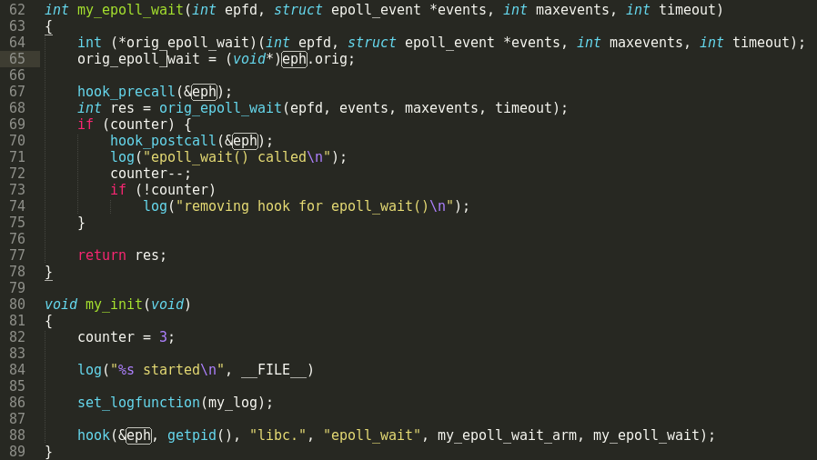
adbi
Example:

Slide 14
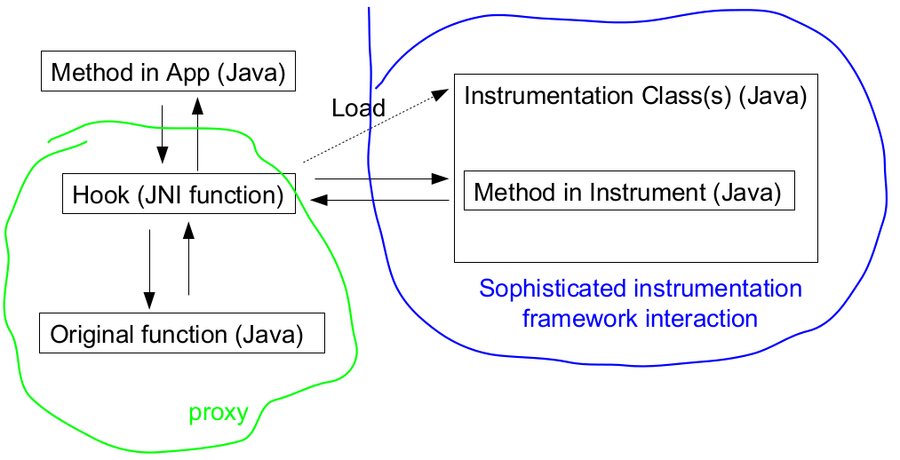
ddi
adbi solves the instrumentation of android binary, does it work for dalvik bytecode?
ddi - hook dalvik method based on adbi

Slide 15
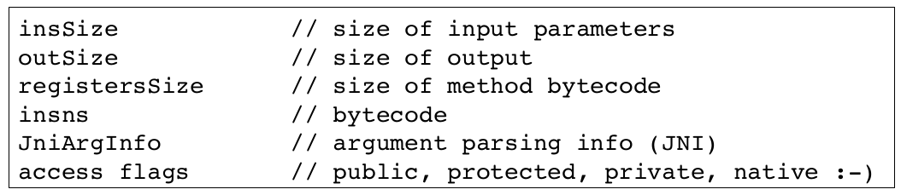
ddi – instrument
Find loaded class
Find method by name and signature
Change method parameters
Convert to JNI method

Slide 16
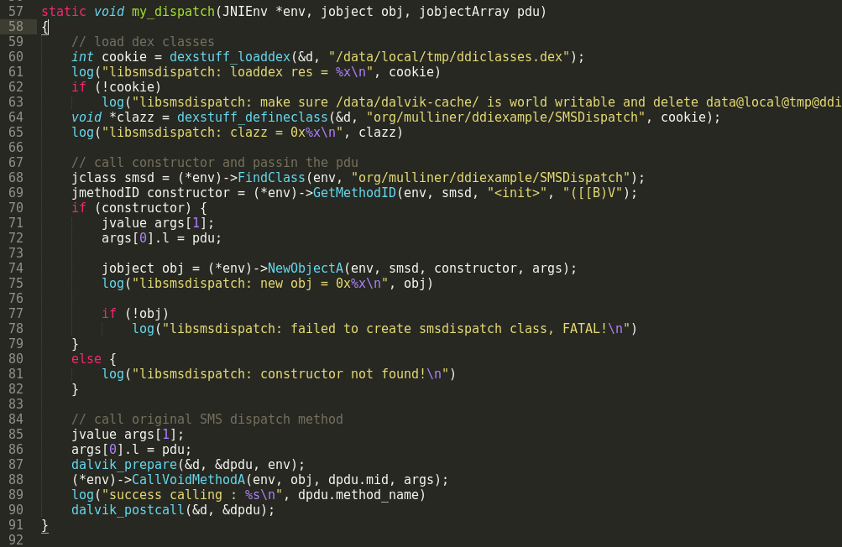
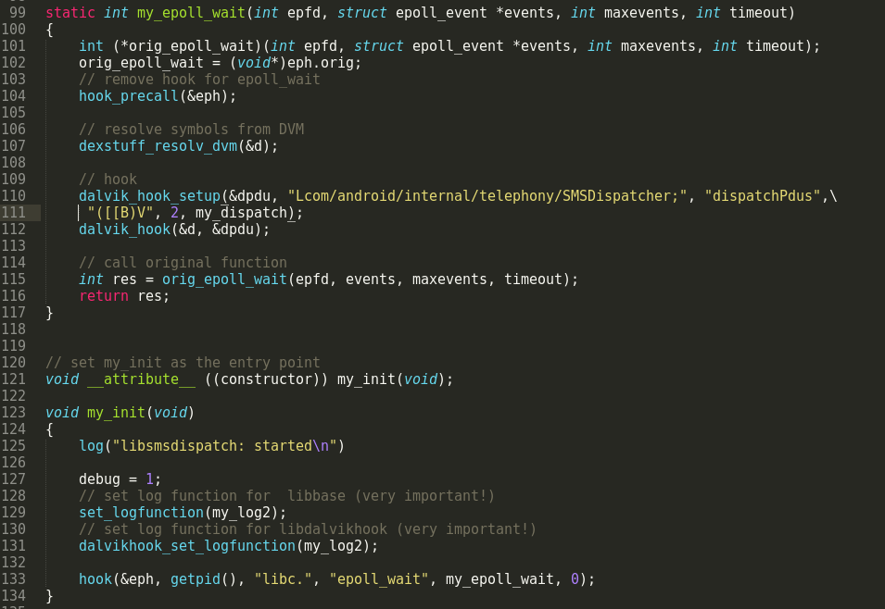
ddi
Example:

Slide 17
adbi && ddi
Advantages :
instrument both binary and dalvik bytecode
portable across different android versions
doesn't break the integrity of the application
Limitations :
may fail when meeting anti-debug techniques
inefficient without the symbol table of the library

Slide 18
Xposed
Xposed[9] – Dynamic dalvik instrumentation platform developed by xda-developers
modify your ROM - without modifying any APK (developers) or flashing (users)!
Similar to adbi&&ddi but more powerful and user-friendly to the developers
More existed modules to use
Hot project : Support Android 5.0

Slide 19
Xposed
Two Main Steps:
1) Inject
replace /system/bin/app_process to load additional XposedBridge.jar just before the VM is created even before the main method of Zygote is called
2) Hook
modify the method you need to hook and change it into native method like ddi

Slide 20
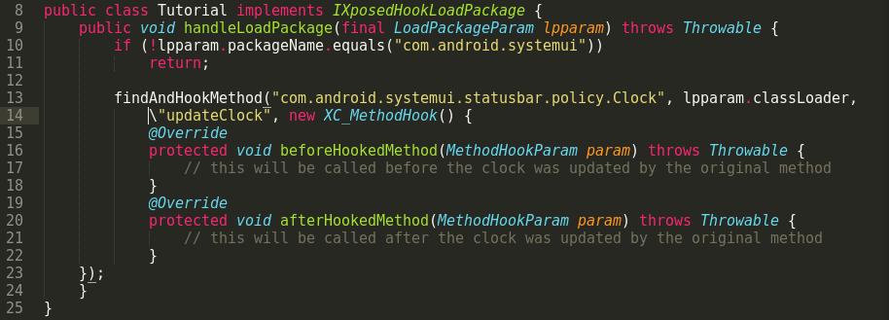
Xposed
Examples: ZJDroid Xpermission Bootloader

Slide 21
Xposed
Other Similar tools:
Cydia's Substrate[10]: for Android and iOS
Injectso[11]: x86 tools transplanted to Android

Slide 22
InDroid
InDroid[12,13]: Developed by SJTU (0ops)
Replace libdvm.so to monitor whatever Dalvik instruction
Work on specific Android versions
Provides extensible Analysis Interface
A fine-grained debuging and logging tools implemented by instrumenting VM

Slide 23
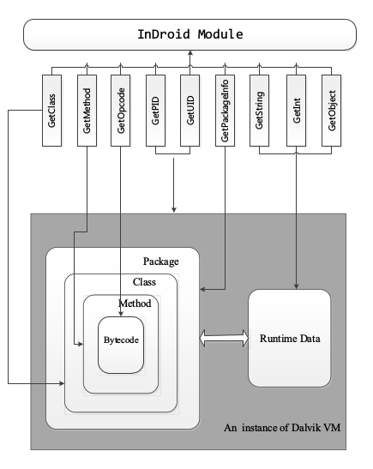
InDroid
Architecture :
– Analysis Interface
– Analysis Module
The Analysis Interface collects the running information of every step of execution

Slide 24
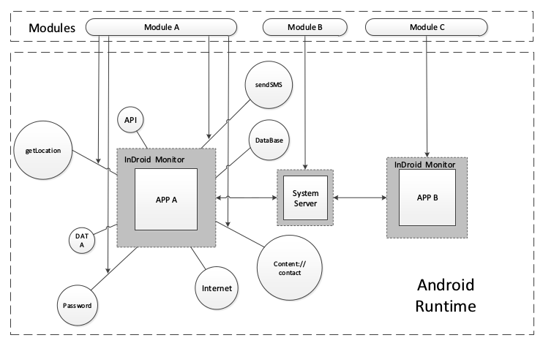
InDroid
Architecture:

Slide 25
InDroid
Example:

Slide 26
InDroid
Advantages:
– easy to deploy (only replace libdvm.so)
– fine-grained monitor
Limitations:
– vary in android versions
– not open-source

Slide 27
DroidScope
DroidScope[14, 15]: A Dynamic Analysis Platform for Android Malware based on QEMU
Provide OS-level and Java-level Instrumentation Interface
Implement several useful plugins
Suitable to perform large-scale analysis
Like a customised ROM used for analyze android malware

Slide 28
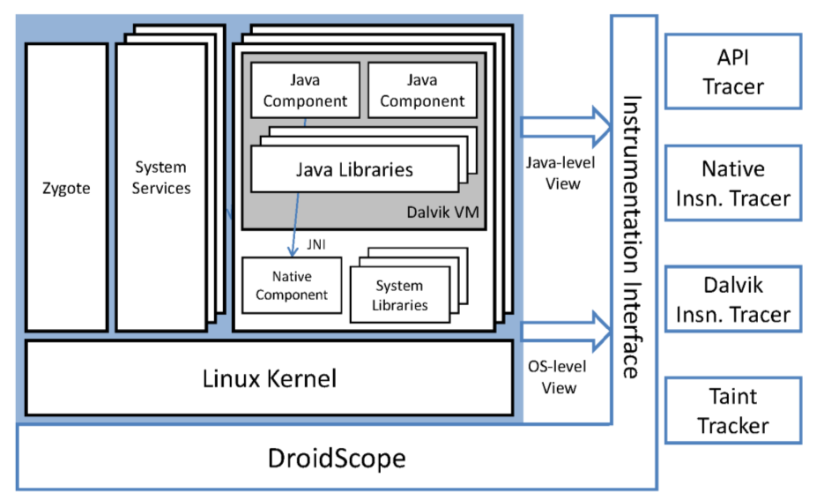
DroidScope
Architecture

Slide 29
DroidScope – OS Level View
Basic Instrumentation:
– insert extra TCG instructions during the code translation phase
Deal with System Calls:
– insert the additional TCG instructions, to call a callback function that retrieves additional information from memory
Maintain Process and threads states
Maintain Memory Map

Slide 30
DroidScope – Dalvik Level View
Instrument the interpreter(mterp) that translate the Dalvik bytecode to machine code
Disable JIT
Maintain DVM states
Interrupt Java object
Maintatin symbol information

Slide 31
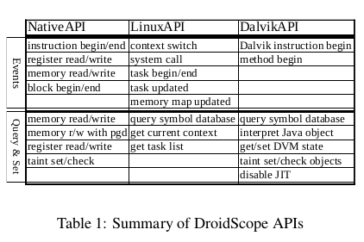
DroidScope
DroidScope API:

Slide 32
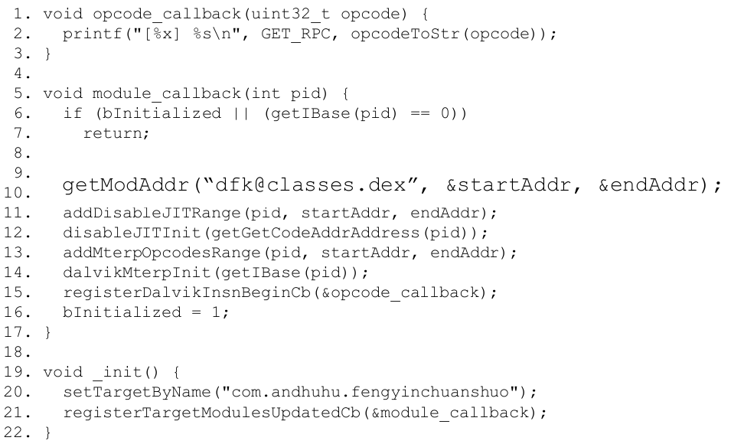
DroidScope
Examples: Dalvik Instruction Tracer

Slide 33
DroidScope
Advantages:
Powerful tool to perform large-scale analysis
Portable to do more analysis based on existed plugins
Fine-grained monitor for analysis
Limitations:
Code coverage
Emulation-resistant malware detect
Limited behavior and worse performance compared to the real mobile devices
More Complicated than the tools previously mentioned

Slide 34
Thinking
Analysis tools and techniques on Linux can be transplanted into Android
A customized ROM for analysis is necessary
New research ideas may come from the deeper understanding about the whole system (ART?)
Track the latest techniques from not only acadamia but also industry

Slide 35
Acknowledge
Chen Kang @ THU
Collin @ mulliner.org
Yan @ Syracuse University

Slide 36
Reference
1. Detours, http://research.microsoft.com/en-us/projects/detours/
2. Valgrind, http://valgrind.org/
3. Pin, https://software.intel.com/en-us/articles/pin-a-dynamic-binary-instrumentation-tool
4. DynamoRIO, http://www.dynamorio.org/
5. adbi, https://github.com/crmulliner/adbi
6. Binary Instrumentation on Android, Collin Mulliner , In SummerCon 2012
7. ddi, https://github.com/crmulliner/ddi
8. Introduction to Dynamic Dalvik Instrumentation, Collin Mulliner , In SummerCon 2013

Slide 37
Reference
9. Xposed, https://github.com/rovo89/Xposed
10. Substrate, http://www.cydiasubstrate.com/
11. Injectso, https://bitbucket.org/tewilove/injectso
12. InDroid, https://github.com/romangol/InDroid
13. DIAS: Automated Online Analysis for Android Applications, J. Li et.al. In ICICT 2014
14. Decaf-platform, https://code.google.com/p/decaf-platform/
15. DroidScope: Seamlessly Reconstructing the OS and Dalvik Semantic Views for Dynamic Android Malware Analysis, Lok Yan et.al. In Usenix Security 2012

